Slide 1

TECHNOLOGY AND INFORMATION MANAGEMENT
TBBT
ADITI SINGH (BILLGATES)

Slide 2
TOPIC: 3 SUCCESSFUL BRANDS WITH DIGITAL TRANSFOMATION

Slide 3

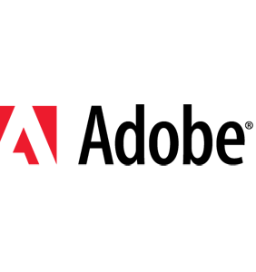
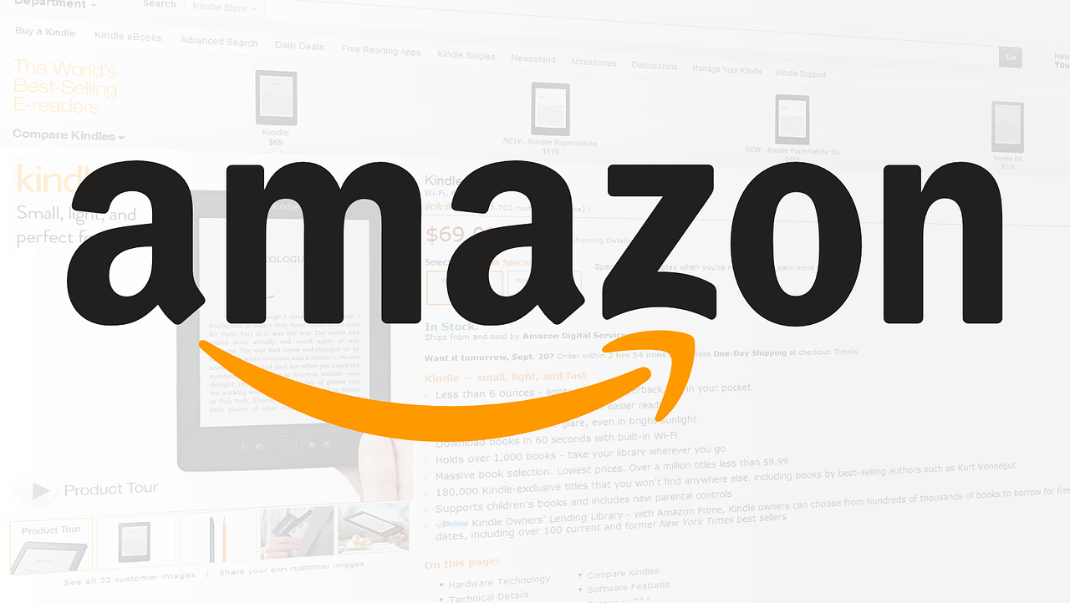
BRAND
AMAZON
NETFLIX
ADOBE

Slide 4

TECHNOLOGIES USED THE BRANDS
AMAZON
Amazon utilizes various technologies across its operations to enhance customer experience, streamline processes, and drive innovation
Operating System: Linux serves as the foundation for Amazon's data centers and cloud computing infrastructure.
Database Technologies: Amazon employs a mix of relational (MySQL, PostgreSQL) and NoSQL (DynamoDB) databases to handle diverse data storage need
Cloud Computing: Amazon Web Services (AWS) is the world's leading cloud platform, providing a wide range of services from compute and storage to machine learning and analytics.

Slide 5
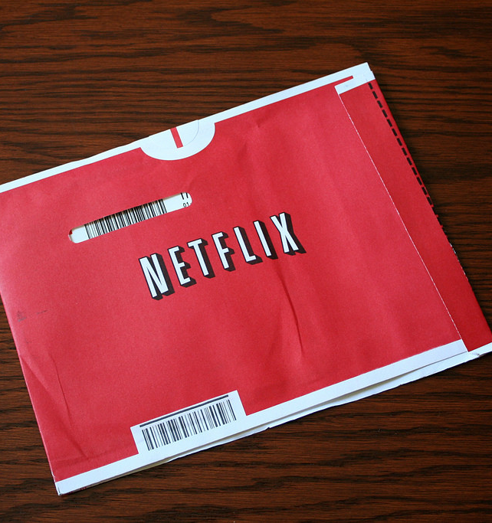
NETFLIX
Netflix uses various technologies to provide its streaming services and enhance user experience.
Architecture for scalability, and Cloud Computing services like Amazon Web Services (AWS) for hosting the platform
Machine Learning and AI: Netflix uses machine learning algorithms to optimize video encoding, improve content recommendations, and enhance streaming quality based on network conditions.
Microservices Architecture: Netflix employs a microservices architecture to enhance scalability and flexibility, allowing different parts of the application to be developed, deployed, and scaled independently.
This Photo by Unknown Author is licensed under CC BY

Slide 6

ADOBE
Adobe utilizes a range of technologies across its products and services to empower creativity, digital experiences, and business solution
Adobe Creative Cloud: Adobe's suite of creative software like Photoshop, Illustrator, and Premiere Pro leverages technologies such as image processing algorithms, vector graphics, and video editing tools to enable creators to bring their ideas to life.
Adobe Experience Cloud: Adobe's digital experience platform incorporates technologies like data analytics, AI, and machine learning to help businesses deliver personalized and engaging customer experiences across various channels.
Adobe Sensei: Adobe's AI and machine learning framework, Sensei, is integrated across Adobe's products to automate tasks, analyze data, and provide intelligent insights to users for improved productivity and creativity.

Slide 7
BEFORE AND AFTER
 | BEFORE | AFTER
AMAZON | Amazon started as an online bookstore, selling a limited selection of products | Today, Amazon offers a vast array of products and services, including e-commerce, cloud computing, content streaming, and more.
NETFLIX | Netflix became a streaming giant, it started as a DVD rental service in 1997, offering DVD rentals by mail. Customers could order DVDs online, receive them via mail, and return them once watched | Netflix shifted its focus to digital content delivery, allowing subscribers to stream movies and TV shows online.
ADOBE | Adobe was known for its creative software like Photoshop and Illustrator, which were widely used for graphic design and photo editing | Adobe has evolved into a comprehensive digital experience company with offerings like Adobe Creative Cloud, Adobe Experience Cloud, and Adobe Document Cloud

Slide 8
STRATEGIES
AMAZON | NETFLIX | ADOBE
Amazon has heavily invested in technology and innovation, developing services like Amazon Web Services (AWS), which offers cloud computing solutions to businesses, and devices like the Kindle and Echo. | Netflix has implemented a multi-faceted strategy to establish itself as a dominant player in the streaming industry. | One key aspect of Adobe's strategy is its focus on subscription-based services like Adobe Creative Cloud, which provides users with access to a suite of creative tools through a monthly subscription.
Amazon strategy involves a combination of initiatives to maintain its position as a leading e-commerce and technology company | One key aspect of Netflix's strategy is its focus on original content production. | Adobe's strategy involves a comprehensive approach to cater to various segments of the digital market
This diversified approach allows Amazon to tap into new markets and increase customer loyalty through subscription services like Amazon Prime, which offers benefits like fast shipping, streaming services, and exclusive deals | Netflix's global expansion strategy has been crucial to its success. | This strategic focus on innovative technologies enables Adobe to stay at the forefront of digital transformation and meet the evolving needs of its users in the creative, marketing, and document management domains

Slide 9

.
AMAZON | NETFLIX | ADOBE
There have been concerns raised about working conditions, employee rights, and labor practices within Amazon's operations. | One of the big challenges for Netflix is the increasing competition in the streaming industry. | Adobe has been proactive in addressing them. They have implemented measures to combat piracy, such as subscription-based models and cloud-based services
Amazon has faced scrutiny over antitrust concerns due to its dominant position in e-commerce and cloud services | Netflix faces the issue of password sharing | Adobe is staying competitive in the rapidly evolving tech landscape
One of the issues Amazon has encountered is criticism over its treatment of workers in its warehouses and fulfillment centers. There have been concerns raised about working conditions, employee rights, and labor practices within Amazon's operations. | Producing original content and licensing popular shows and movies can be quite expensive | One of the main issues for Adobe is software piracy. Due to the popularity of Adobe's creative software like Photoshop and Illustrator, there's a significant problem with unauthorized copying and distribution of their products, which can impact their revenue and intellectual property rights.

Slide 10

DIGITAL TRANSFORMATION
One of the key areas of digital transformation for Amazon has been its focus on enhancing the customer experience through innovations like Amazon Prime, one-click ordering, and personalized recommendations. These initiatives have helped Amazon streamline the shopping experience and build customer loyalty
Netflix has been utilizing data analytics and machine learning to personalize recommendations for users, improve content discovery, and optimize streaming quality. By leveraging data-driven insights, Netflix can enhance user satisfaction and retention, ultimately driving its digital transformation efforts
Adobe has been focusing on digital marketing and e-commerce solutions through platforms like Adobe Experience Cloud. By integrating data analytics, artificial intelligence, and personalized customer experiences, Adobe helps businesses optimize their digital strategies and improve customer engagement in the digital realm

Slide 11


